Slide 1
Quantitative text analysis: structural topic modelling (STM)
Michael Marshall
Urban Studies and Planning, University of Sheffield

Slide 2
Welcome
Michael Marshall
Research Associate in Urban Studies and Planning (USP)
Research the political economy of housing (i.e. markets, policy and governance), but also the politics of wealth inequality, net zero, conspiracy theories, and political leadership style
Quantitative text analysis projects:
Changing style of political leaders in the UK Labour Party
How UK Members of Parliament talk about housing policy in parliamentary speeches, and how it has changed over time
Understanding regulatory reform in the English affordable housing sector

Slide 3
Content
Topic modelling. What is it? What is it used for?
Structural topic modelling (STM). Theory and examples
STM strengths and limitations
Practical
Break
Practical continued
Alternative quantitative text analysis methods and further resources

Slide 4
Topic modelling
Unsupervised learning models for quantitative text analysis
Automated content analysis
Identification of themes (i.e. topics) within a text corpus
Assumes a data generating process for the documents, uses the data to find most likely parameters for the assumed generative model
Uses word counts and co-occurrence of words within documents to estimate the model
Probabilistic identification of topics within documents
Mixture of topics over words i.e. probability of words belonging to topics
Mixture of topics over documents i.e. proportion of a document associated with a topic
Examples include:
Latent Dirichlet Allocation (LDA)
Correlated topic model
Structural topic model (STM)

Slide 5
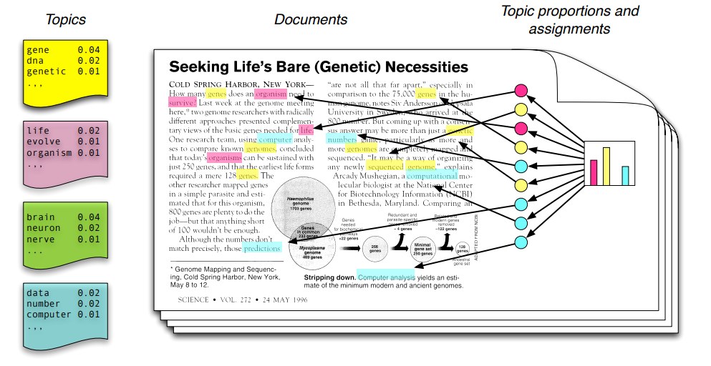
Topic modelling

Slide 6
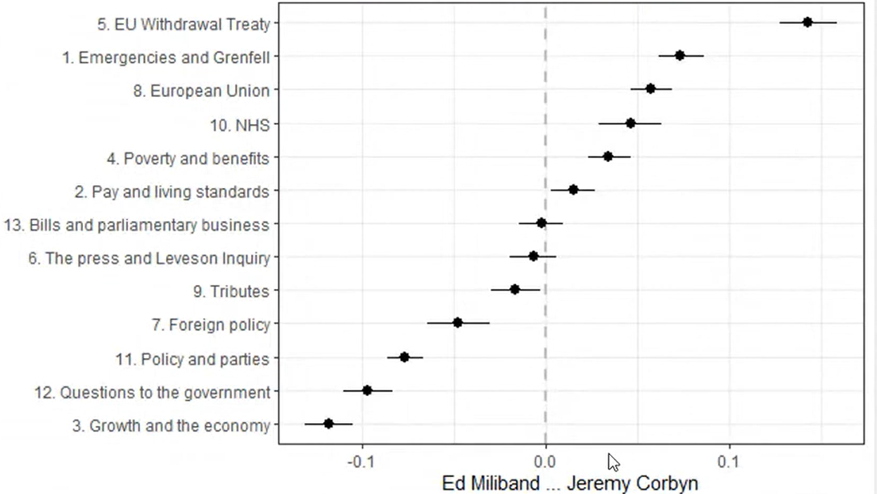
STM
Probabilistic topic model that uses document metadata – known as covariates – to identify topics
Covariate examples: author’s political party, publication date, country in which it’s published
Assumes that covariates are fundamental to the data generation process
Topic prevalence and content can vary according to covariates
Prevalence is the amount a topic is discussed; it is variation between topics e.g. political leaders with contrasting ideologies will talk about different topics to varying extents
Content is the words used to discuss a given topic; it is variation within topics e.g. newspapers with contrasting political positions use different words to discuss women

Slide 7
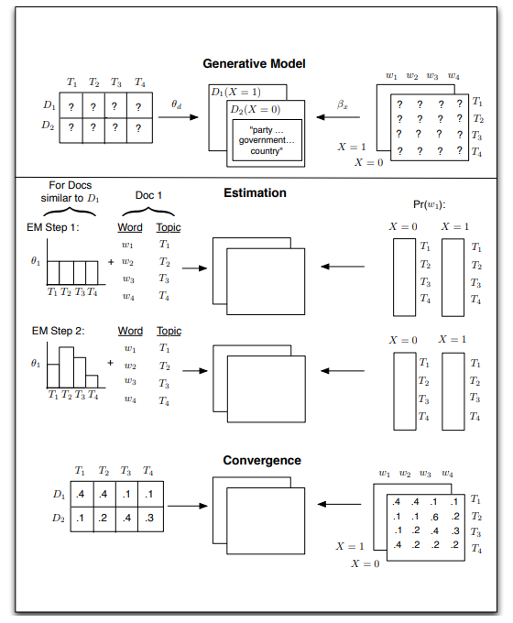

Slide 8
STM
Number of topics (K) must be specified in advance
Topics are commonly validated through a combination of quantitative and qualitative techniques
Quantitative goodness of fit measures
Heldout-likelihood – how well does the model predict the topic probability of a heldout fraction of words?
Semantic coherence – a high score means the high probability words in a topic frequently co-occur together
FREX – a weighted mean that balances the frequency with which a word is discussed in a topic with the exclusivity of the word to that topic; a higher score is better
Qualitative validation
Read the documents. This is very, very, very important! If you take one thing from today, it is that STM is not a substitute for reading the documents
Inspect the high probability words in a topic. Do they make sense?
Theory and predictive accuracy e.g. do the topics correspond to real world events?
Hybrid approaches
Does the STM model predict human coding of documents?

Slide 9
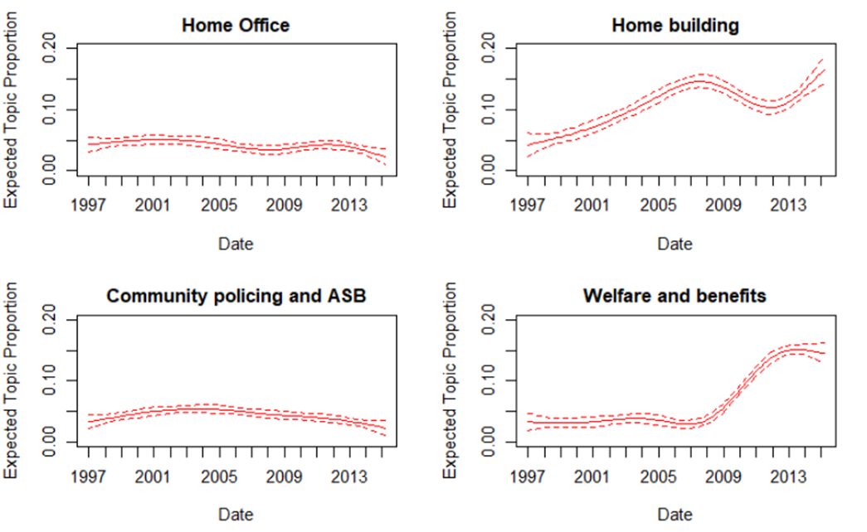
STM
Predictive accuracy – topic prevalence for welfare reform in speeches on housing corresponds to period of austerity

Slide 10
STM
Example applications
Understanding barriers to compliance with COVID-19 guidelines from free-text survey responses (Wright et al., 2022)
Using reflective essays from students to understand the experience of studying abroad (Grajzl and Irby, 2019)
Exploring citizen preferences for tackling climate change using open-ended survey questions, and how preferences vary according to gender (Tvinnereim et al., 2017)
Analysing the stances taken by politicians on housing policy in UK parliamentary speeches, and how those stances vary according to housing conditions in an MP’s constituency (Ansell, Bokobza and Nyrup, 2022)

Slide 11
STM strengths
Well suited to exploratory analysis of large text corpora
This is true of topic models generally
Inclusion of covariates can improve estimation process
Covariates give the model important prior information on the latent topics
Social scientific research questions are often interested in how topics vary with covariates
e.g. differences in prevalence or content according to political party

Slide 12
STM limitations
No agreed upon process for topic validation
Again, this applies to topic models generally
Reliant upon post-hoc interpretation of topics
“Reading the tea-leaves”
Unsupervised learning not always conducive to topic measurement
Some projects are concerned with a specific topic, and then try to use STM to measure the prevalence of that topic, but there is no guarantee that the topic will be identified by the model
Semi-structured topic models and scaling methods have been proposed in response e.g. keyword assisted topic modelling, latent semantic scaling
Solutions can be unstable to the choice of hyperparameters
e.g. the number of K topics, the initialisation of the STM algorithm
One option is to produce many models, but there can be a trade-off with interpretability
Better suited to longer texts
e.g. tweets might be just a few words

Slide 13

Practical
Housing Studies journal abstracts
All abstracts from 2000-2023
Accessed via Scopus API
Includes a variety of metadata, including author, author affiliations, citation number, keywords, and whether the paper uses quantitative methods
Research questions:
Are there differences in topic prevalence according to whether the author works in an Anglophone nation?
How have differences in topic prevalence changed over time?

Slide 14
Practical
https://github.com/michael-s-marshall/FoSS-STM-training

Slide 15
Practical: what we have covered
An introduction to cleaning text data in R
Creating covariates
Creating and inspecting text-based data objects e.g. corpus, tokens, document feature matrix (dfm)
Identifying the potential number of topics through searchK
Running, inspecting and validating STM
Estimating the effects of covariates on topic prevalence
Visualising results

Slide 16
Practical: extensions we have not covered
More complex prevalence formula e.g. interaction between year and country
Inclusion of a content covariate
Producing multiple models to validate the stability and accuracy of results
Validation through third party or crowd-sourced human judgement

Slide 17
Other quantitative text methods
Semi-supervised methods
keyATM (Eshima, Imai and Sasaki, 2023)
Word embeddings supported by dictionaries (Hargrave and Blumenau, 2022)
Scaling methods
Wordscores (Laver, Benoit and Garry, 2003)
Latent semantic scaling (LSS) (Watanabe, 2021)
Supervised learning for text classification
Classify texts using machine learning such as support vector machines, random forests, or naïve bayes
Reliant upon having a pre-coded training sample

Slide 18
Further resources
General quantitative text analysis references
Benoit, K. ‘Text as Data: An Overview’. Available here: https://kenbenoit.net/pdfs/CURINI_FRANZESE_Ch26.pdf
Grimmer, J., Roberts, M. E., and Stewart, B. M. (2022). Text as Data: A New Framework for Machine Learning and the Social Sciences.
STM
Roberts, M. E., Stewart, B. M., & Tingley, D. (2019). stm: An R Package for Structural Topic Models. Journal of Statistical Software, 91(2), 1–40. https://doi.org/10.18637/jss.v091.i02
Weston, S. J., Shryock, I., Light, R., and Fisher, P. A., (2023). Selecting the Number and Labels of Topics in Topic Modeling: A Tutorial. Advances in Methods and Practices in Psychological Science. 6(2), 1-13.

Slide 19
References
Ansell, B., Bokobza, L., & Nyrup, J. (2022). From your house to their House? Representation, Political Rhetoric and Housing Markets. Working Paper
Eshima, S., Imai, K. and Sasaki, T. (2023). Keyword-Assisted Topic Models. American Journal of Political Science. https://doi.org/10.1111/ajps.12779
Grajzl, P. & Irby, C. (2019). Reflections on study abroad: a computational linguistics approach. Journal of Computational Social Science. 2, 151–181. https://doi.org/10.1007/s42001-019-00038-8
Hargrave, L., & Blumenau, J. (2022). No Longer Conforming to Stereotypes? Gender, Political Style and Parliamentary Debate in the UK. British Journal of Political Science, 52(4), 1584-1601. doi:10.1017/S0007123421000648
Laver, M., Benoit, K., & Garry, J. (2003). Extracting Policy Positions from Political Texts Using Words as Data. American Political Science Review, 97(2), 311-331. doi:10.1017/S0003055403000698
Tvinnereim, E., et al. (2017). Citizens’ preferences for tackling climate change. Quantitative and qualitative analyses of their freely formulated solutions. Global Environmental Change. 46, 34-41. https://doi.org/10.1016/j.gloenvcha.2017.06.005.
Watanabe, K. (2021) Latent Semantic Scaling: A Semisupervised Text Analysis Technique for New Domains and Languages. Communication Methods and Measures, 15:2, 81-102, DOI: 10.1080/19312458.2020.1832976
Wright, L., Paul, E., Steptoe, A. et al. Facilitators and barriers to compliance with COVID-19 guidelines: a structural topic modelling analysis of free-text data from 17,500 UK adults. BMC Public Health. 22, 34 (2022). https://doi.org/10.1186/s12889-021-12372-6

